Slide 1

<CityLearn Challenge>
Project Report
<Dec 8, 2022>
Prepared by: <Hedieh and Rauan>

Slide 2



Problem statement
Minimize
Emission
Grid load
Electricity cost

Slide 3
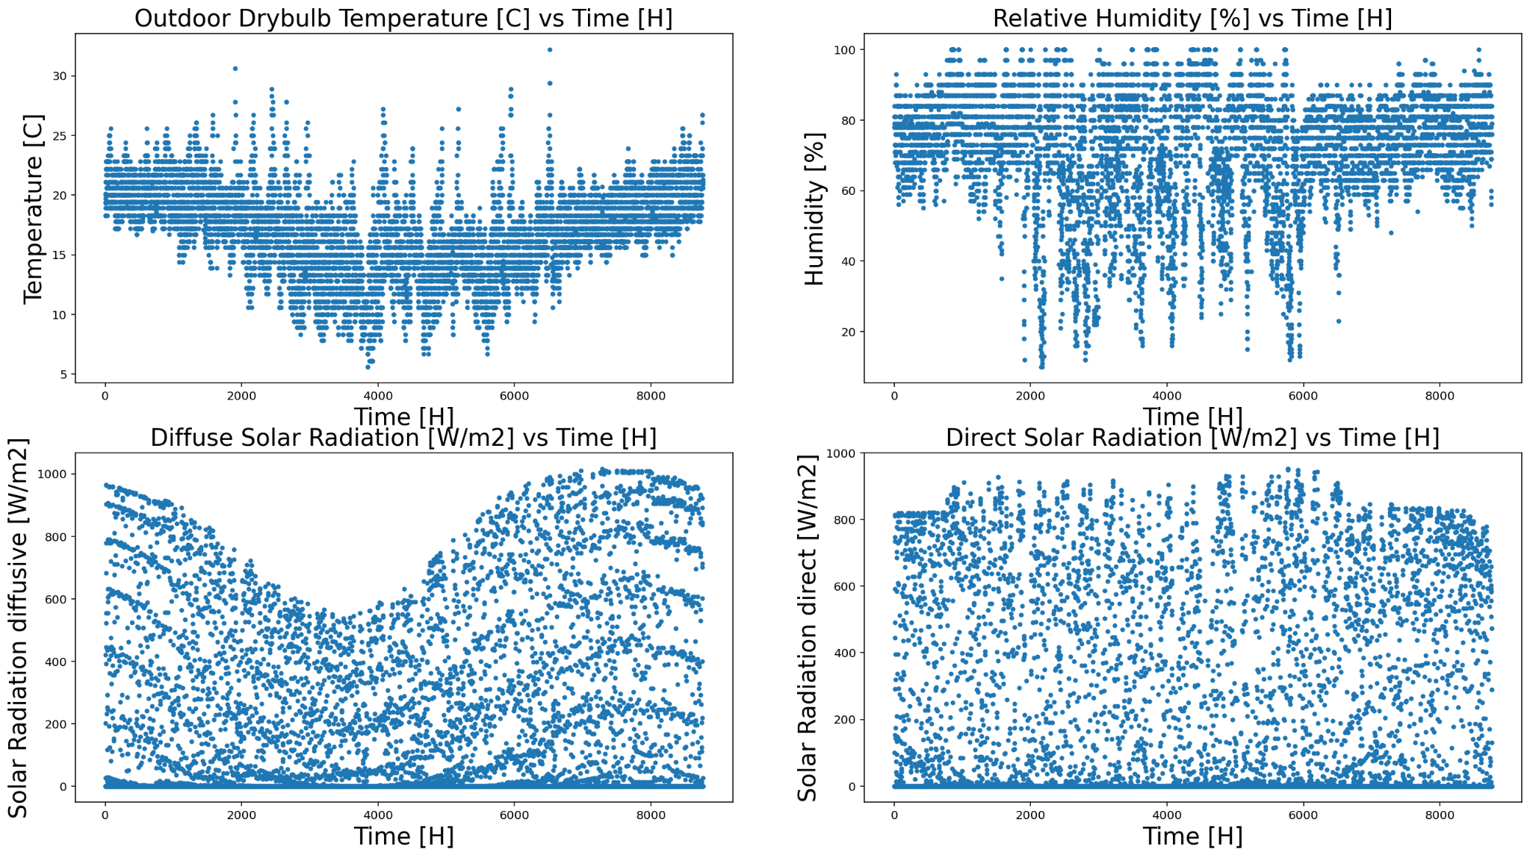
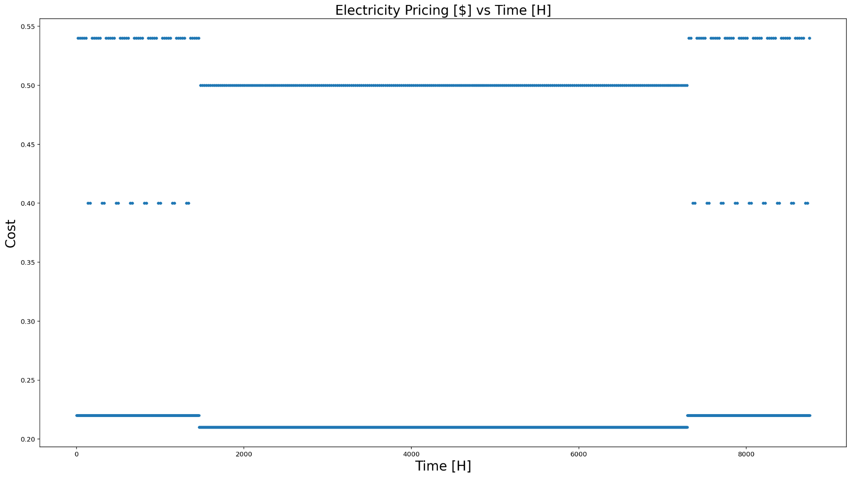
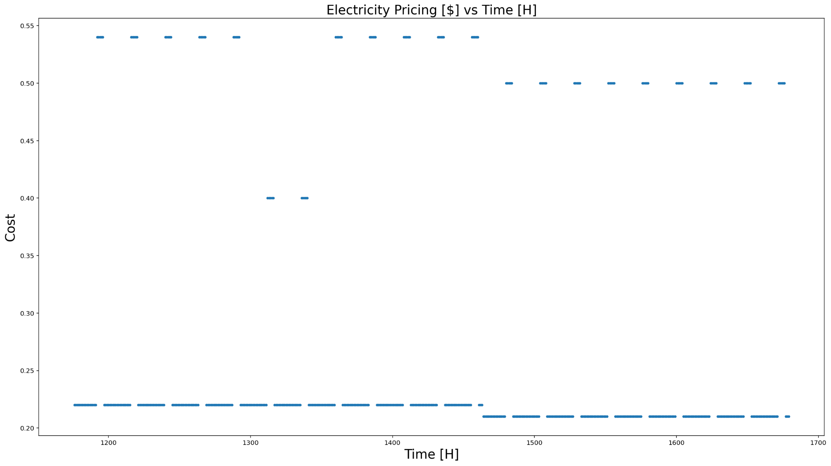
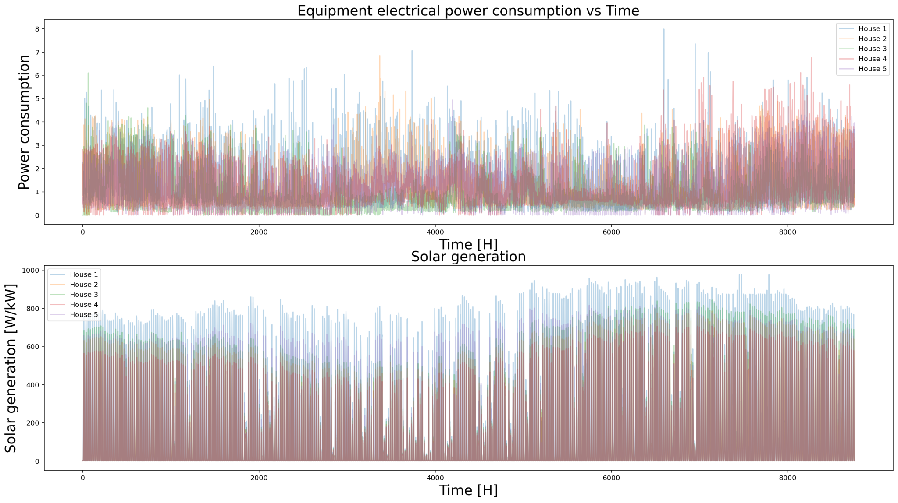
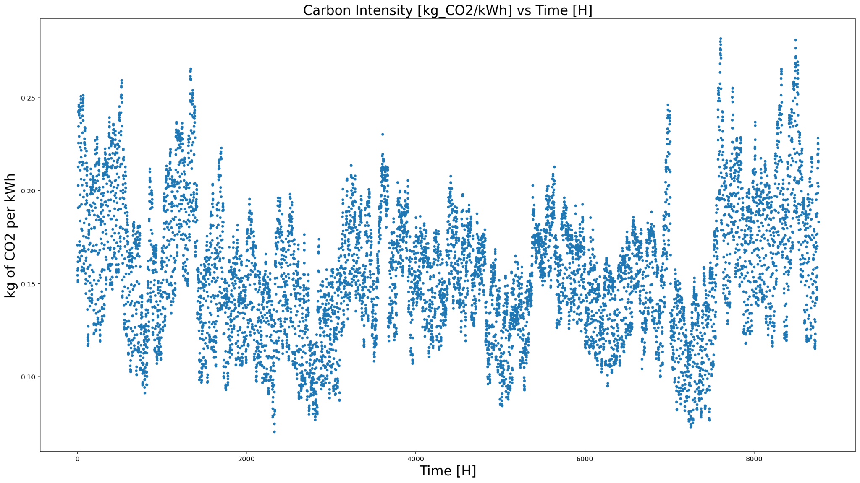
Data overview
Weather
Electricity cost
Consumption/Generation of electricity
Carbon intensity

Slide 4
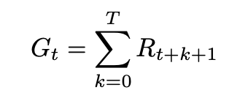
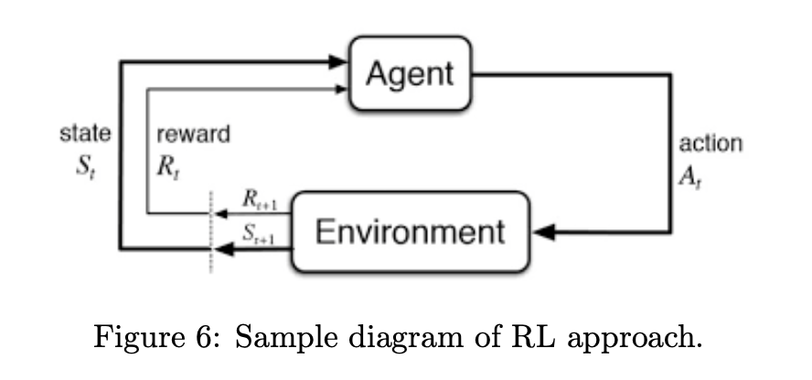
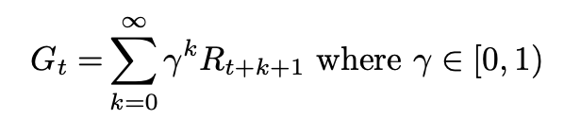


Cumulative reward
Reinforcement Learning
Adding discount rate
• State input
• Action performance
• Environment changes
• Environment rewards agent
Episodic vs Continuous
Value
Policy

Slide 5
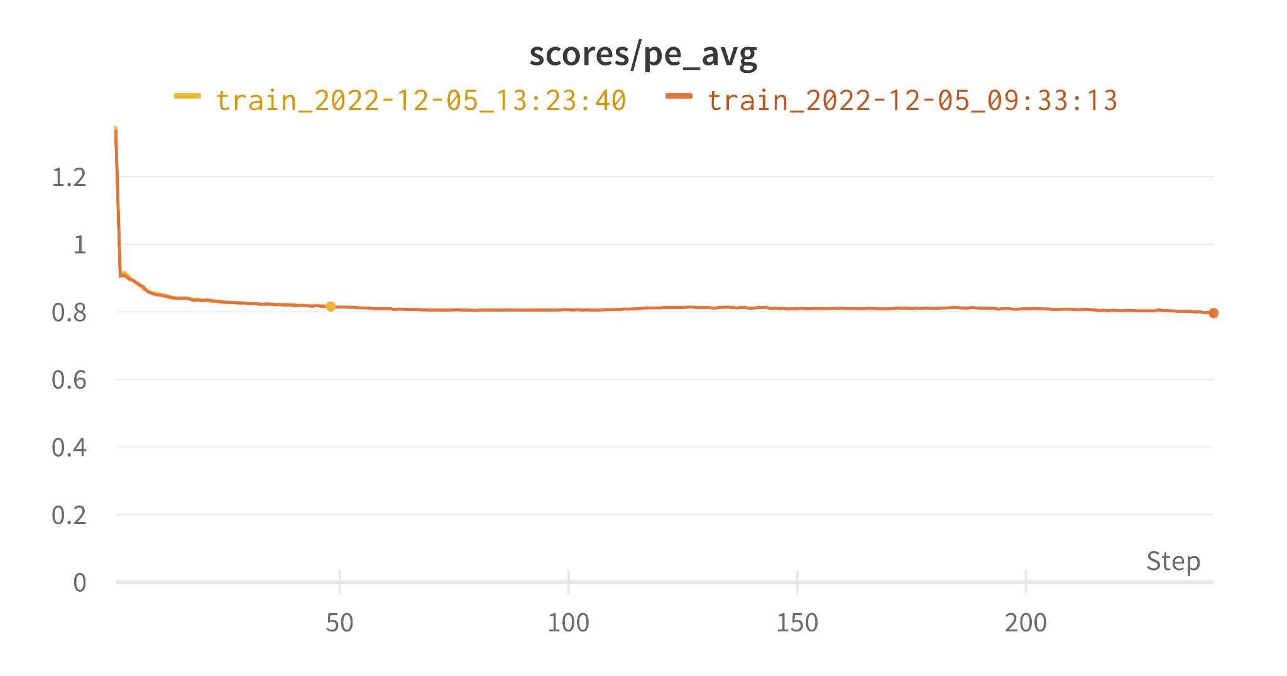
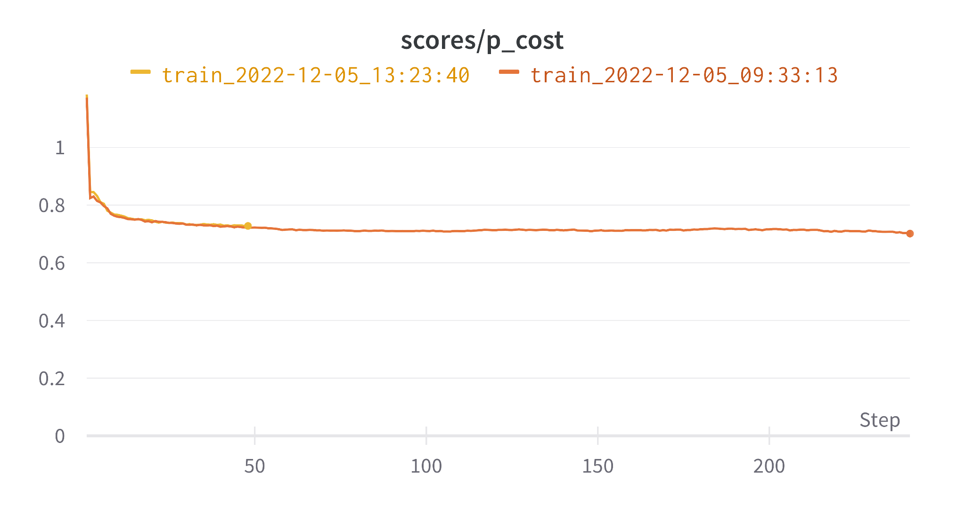
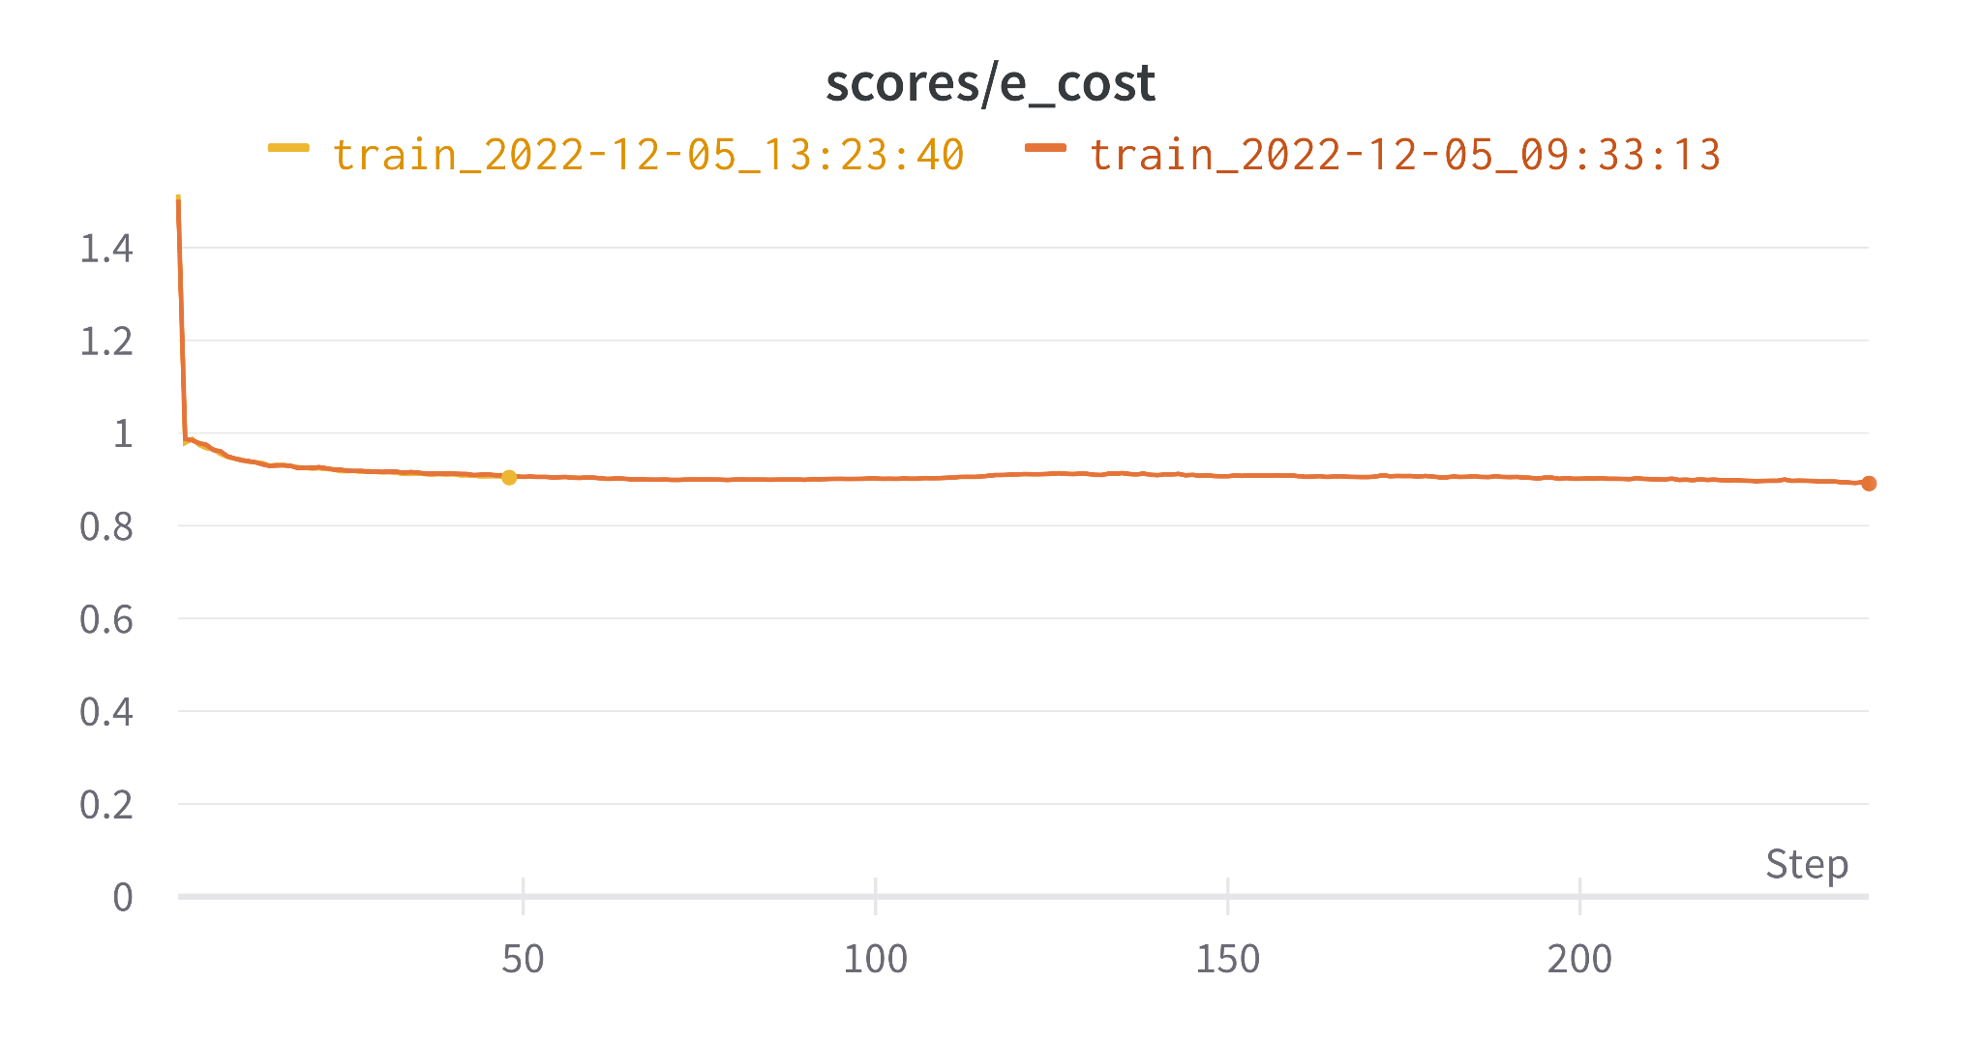
Results
Average
Price score
Emission score

Slide 6
Project Activities

